Slide 1
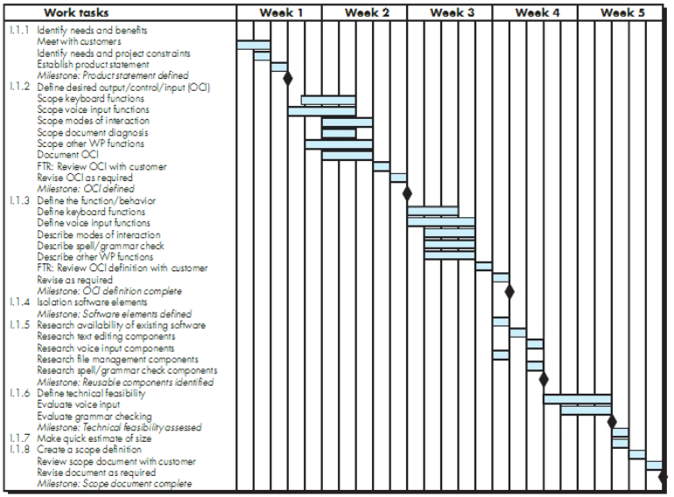
Gantt Chart

Slide 2
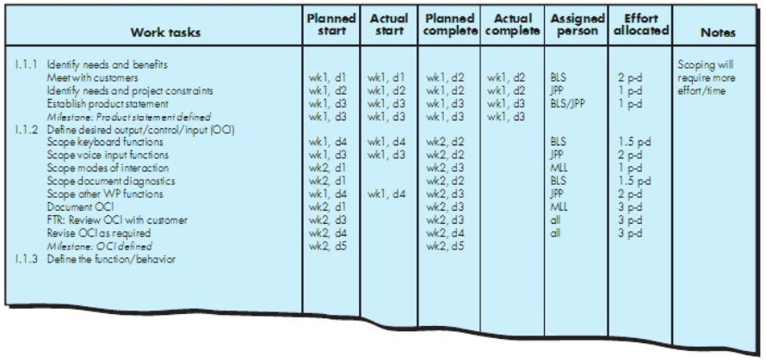
Gantt Chart

Slide 3
References
Pfleeger SE Book
Pressman SE Book
Acknowledgement
A few slides have been reused from UCF slides for the SE course

